Slide 1
The Price is Right!

Slide 2
GOALS
1. HELP EDUCATE WHICH MANUFACTURES ARE A PART OF INDEAL.
2. PROVIDE ALTERNATES FOR CURRENT NON-INDEAL VENDOR PRODUCTS.
3. SHOW FUN/NEW PRODUCTS THEY DID NOT KNOW ABOUT!

Slide 3
WHAT MANUFACTURE DOESN’T BELONG
LOFT WALL
MAGNUSON GROUP
TENNSCO
ARCADIA
ESI

Slide 4
WHAT MANUFACTURE DOESN’T BELONG
LOFT WALL
MAGNUSON GROUP
TENNSCO
ARCADIA
ESI

Slide 5
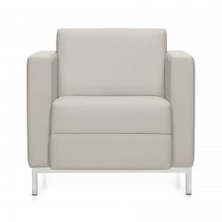
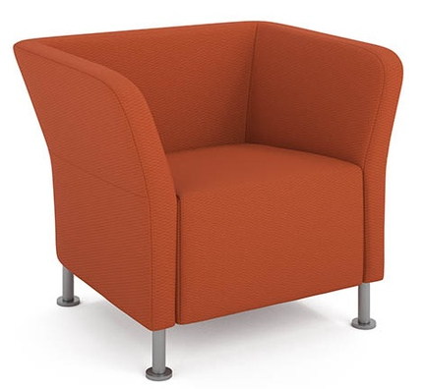
THE PRICE IS RIGHT…MATCH UP THE LIST PRICE WITH THE LOUNGE CHAIR
$1,119.00
$1,175.00
$1,621.00
SOURCE - VEE
GLOBAL – CITI SQ
HON - FLOCK

Slide 6
THE PRICE IS RIGHT…MATCH UP THE LIST PRICE WITH THE LOUNGE CHAIR
$1,119.00
$1,175.00
$1,621.00
SOURCE – VEE
$1,119.00
GLOBAL – CITI SQ
$1,175.00
HON – FLOCK
$1,621.00

Slide 7
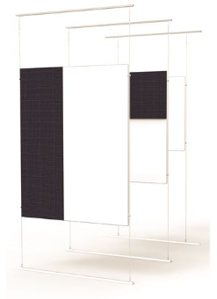
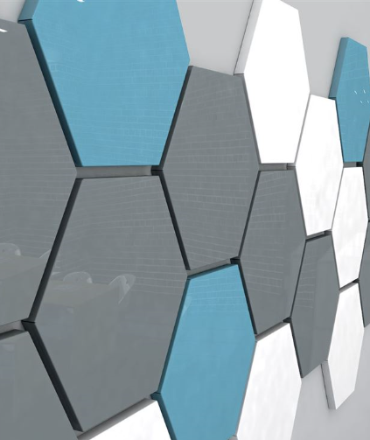
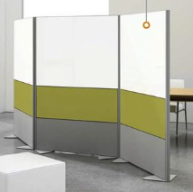
THE PRICE IS RIGHT…MATCH UP THE MANUFACTURE WITH IT’S PRODUCT
CLARIDGE
EGAN
GHENT
HEX WHITEBOARDS
TENSION WIRE WHITEBOARD/TACK
FREE STANDING
ROOM DIVIDER WHITEBOARD/TACK COMBO

Slide 8
THE PRICE IS RIGHT…MATCH UP THE MANUFACTURE WITH IT’S PRODUCT
CLARIDGE
EGAN
GHENT
HEX WHITEBOARDS
GHENT
TENSION WIRE WHITEBOARD/TACK
EGAN VISUAL
FREE STANDING
ROOM DIVIDER WHITEBOARD/TACK COMBO
CLARDIGE

Slide 9
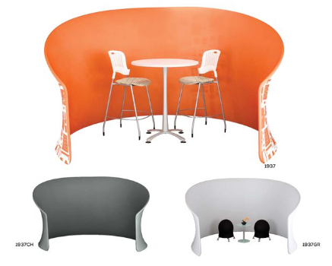
NAME THAT MANUFACTURE

Slide 10
NAME THAT MANUFACTURE
SAFCO!!!

Slide 11
NAME THAT MANUFACTURE
SAFCO!!!
$2345 (HIGH/LOW)

Slide 12
NAME THAT MANUFACTURE
SAFCO!!!
HIGH – ACTUAL PRICE $2095

Slide 13
NAME THAT MANUFACTURE
SAFCO!!!
$2095 STANDARD SCREEN
$2345 CUSTOM GRAPHIC

